Slide 1
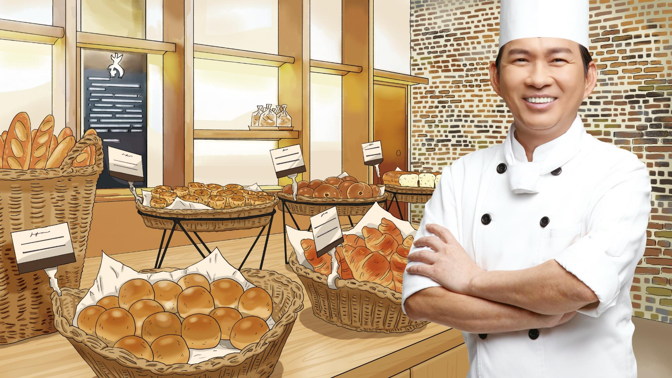
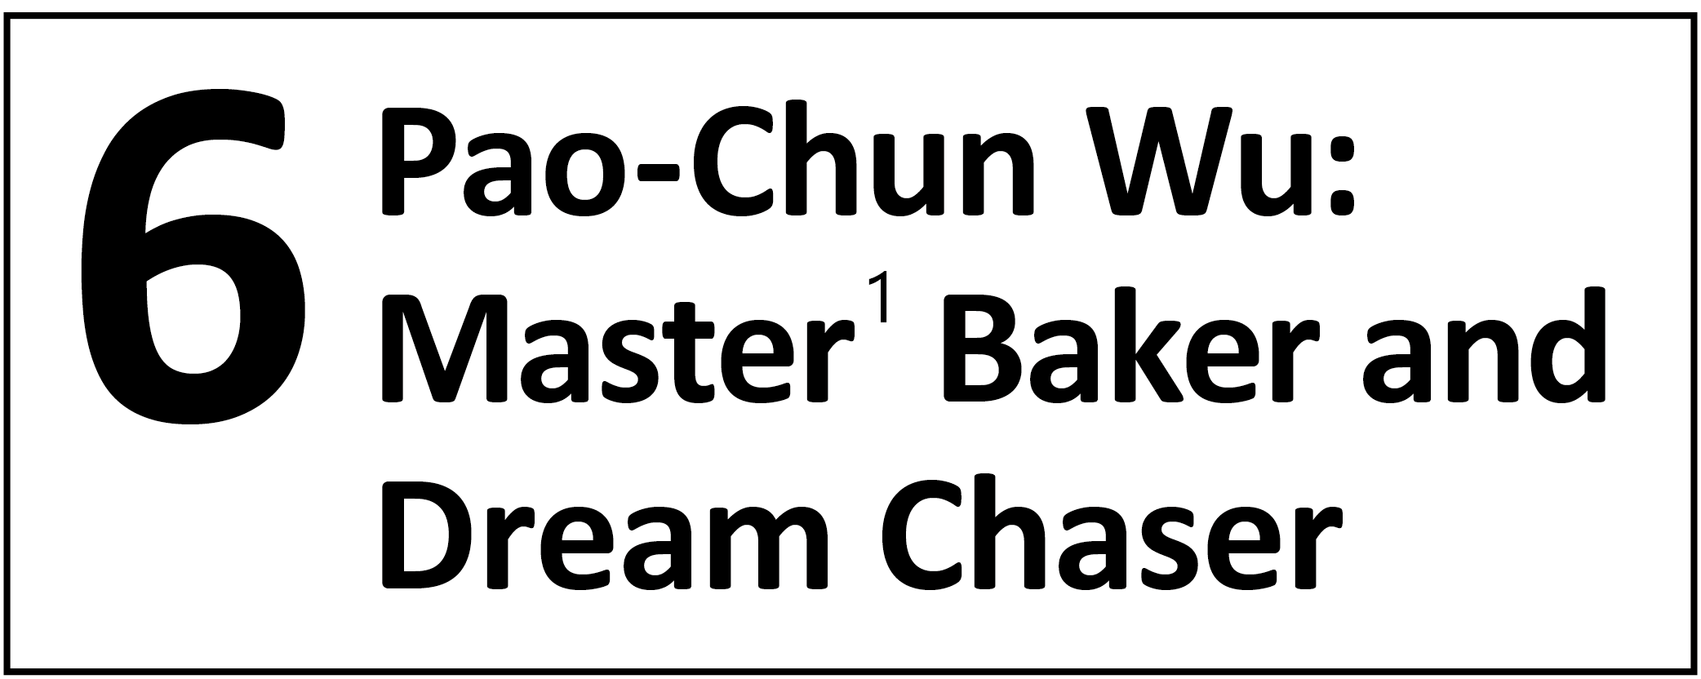
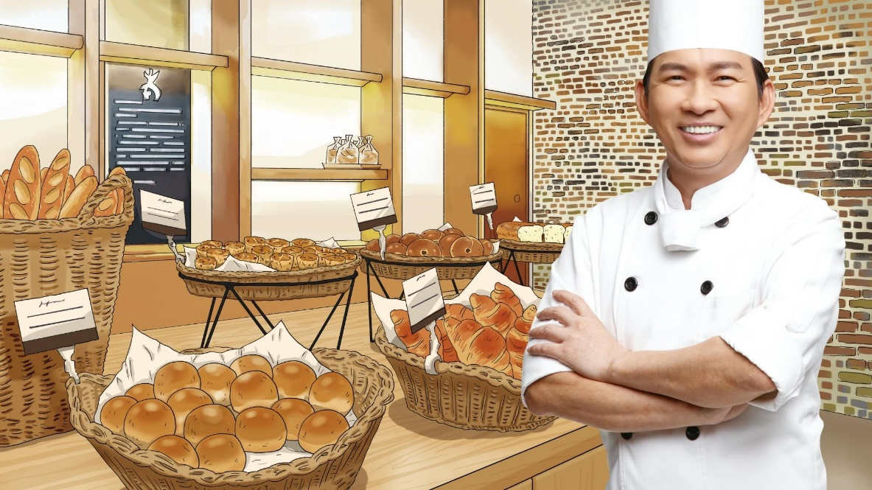

Slide 2
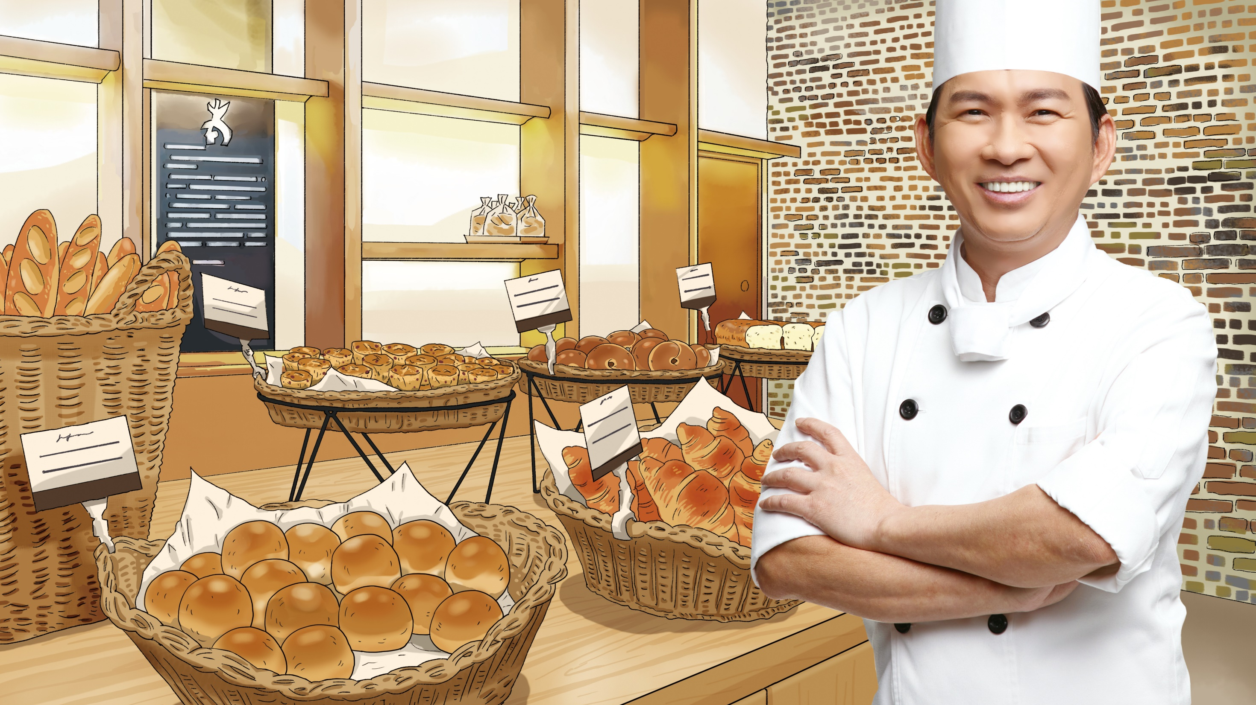
Check out the different kinds of delicious bread on the shelf of the bakery! How often do you visit a bakery or eat bread? What kind of bread is your favorite and why?
bagels (貝果)
baguettes (法式長棍麵包)
loaves (條) of bread
muffins (鬆糕；瑪芬)
croissants (可頌)
buns (小圓麵包)

Slide 4
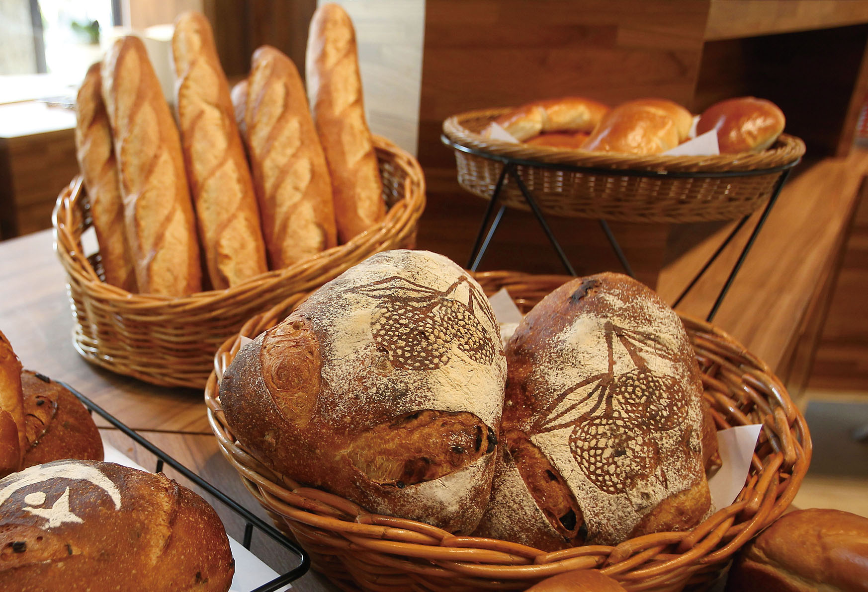
第一段
1
The smell of delicious fresh bread is in the air.
美味又新鮮的麵包香氣瀰漫在空氣之中。

Slide 5
第一段
2
This bread came from the hands of Pao-chun Wu, the winner of the “World Cup of Baking.”
這麵包來自於「世界盃麵包大賽」贏家吳寶春的巧手。

Slide 6
第二段
3
Master Wu was born into a poor family with eight children in Pingtung County◎.
吳師傅出生於屏東縣，家中有八個孩子，家境貧困。

Slide 7
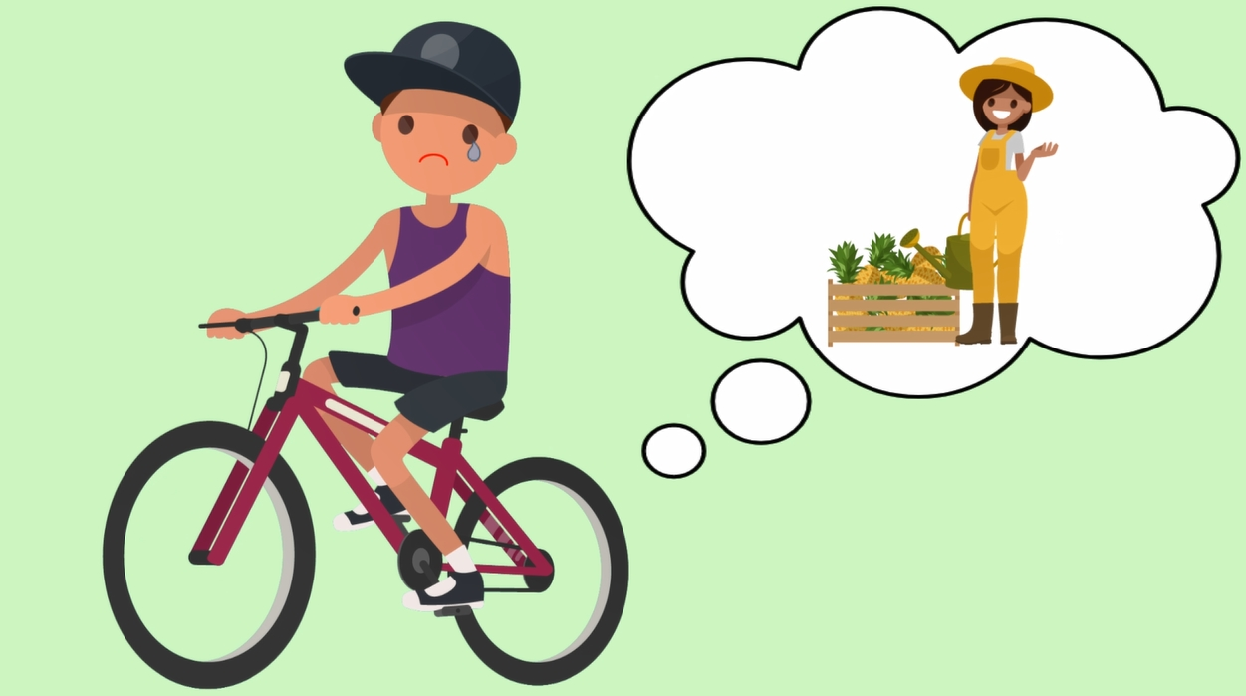
第二段
His father died when he was just 12, and his mother had to work very hard to make ends meet.
在他年僅十二歲時，父親就過世了，而他的母親必須非常努力地工作以維持生計。

Slide 8
第二段
In school, Wu did not perform² well.
在學校，吳師傅的表現並不出色。

Slide 9
第二段
After he finished middle school, he decided³ not to continue⁴ his studies.
完成國中學業後，他決定不再繼續升學。

Slide 10
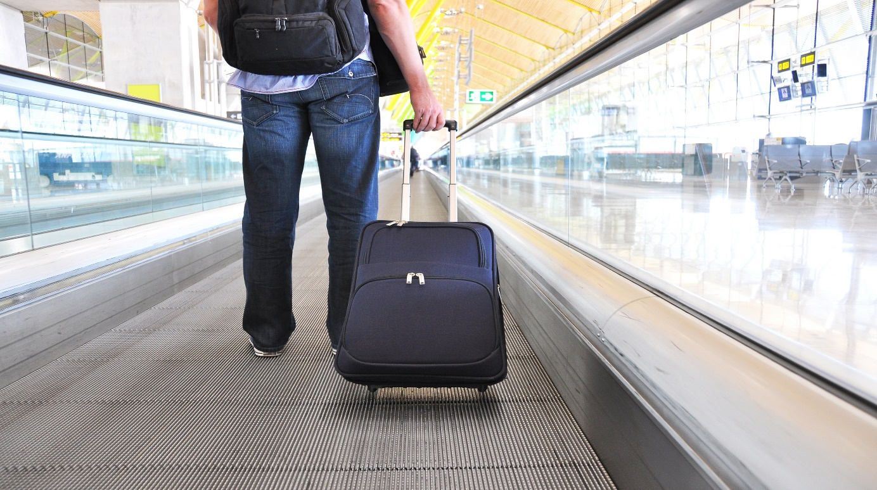
第三段
When Wu was 16, he began the next stage⁵ of his life.
十六歲時，吳師傅開啟了人生的下一個階段。

Slide 11
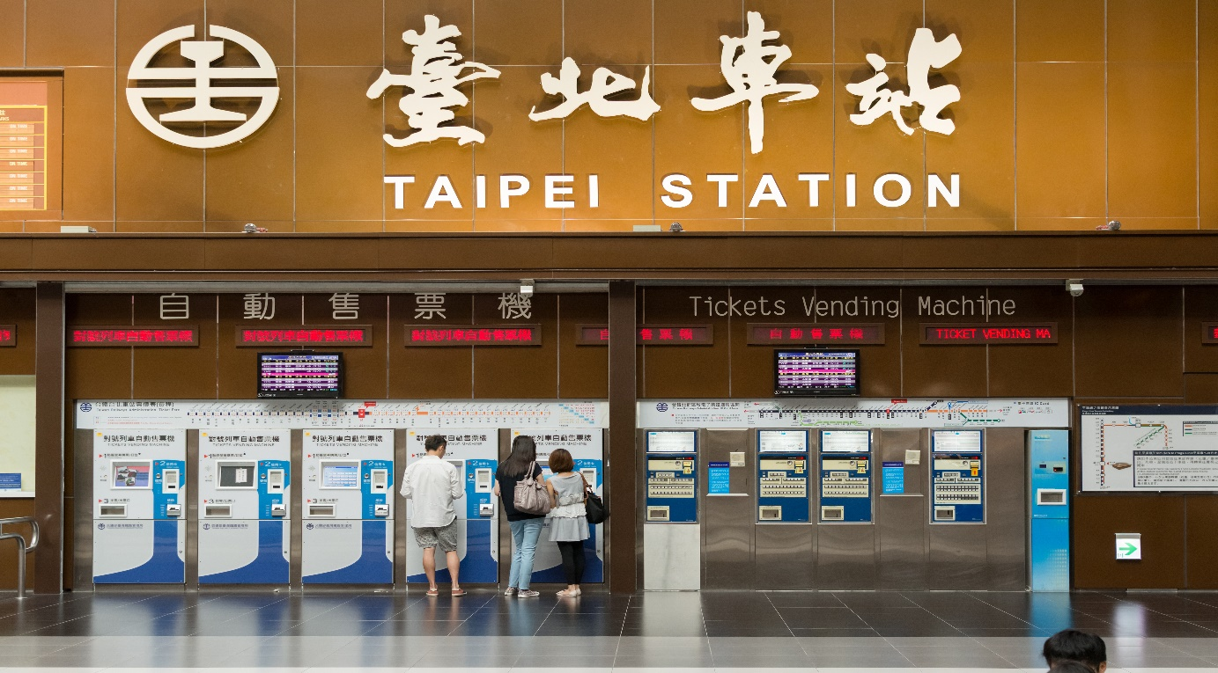
第三段
4
His mother gave him 50 dollars and a train ticket to Taipei.
他的母親給了他五十元和一張到臺北的火車票。

Slide 12
第三段
Then he started to work in a small bakery in Muzha.
接著，他就開始在木柵的一間小麵包坊工作。

Slide 13
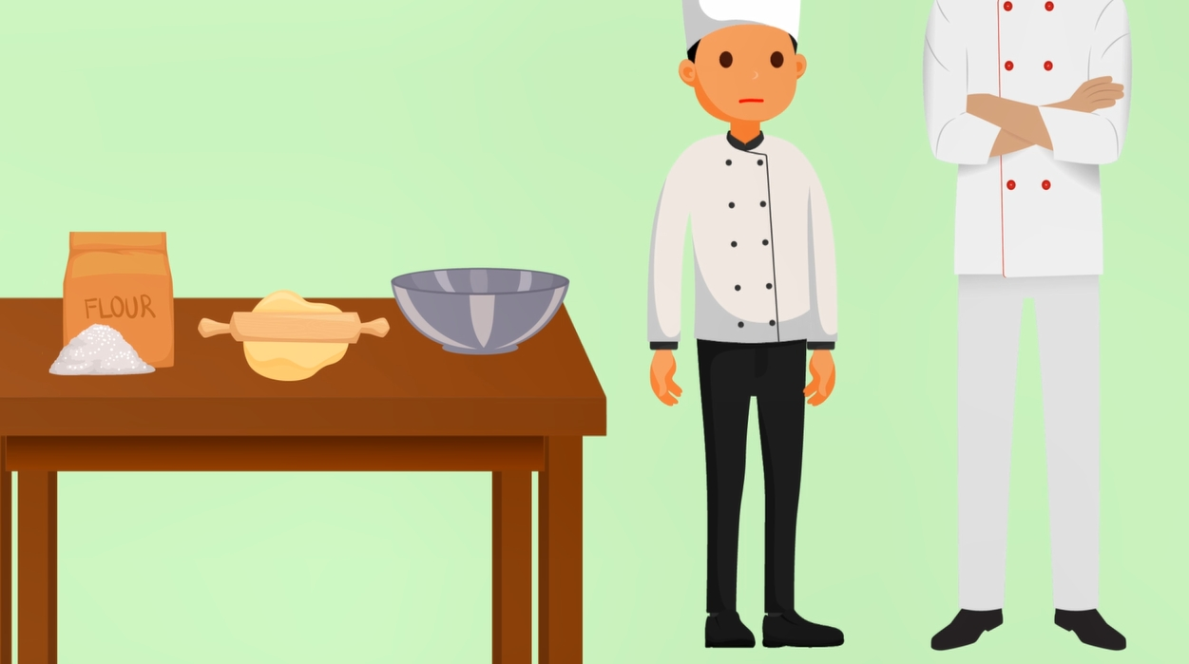
第三段
Wu did not have much education⁶, and this made things very hard for him.
吳師傅沒有接受太多的教育，這讓許多事對他而言顯得特別艱辛。

Slide 14
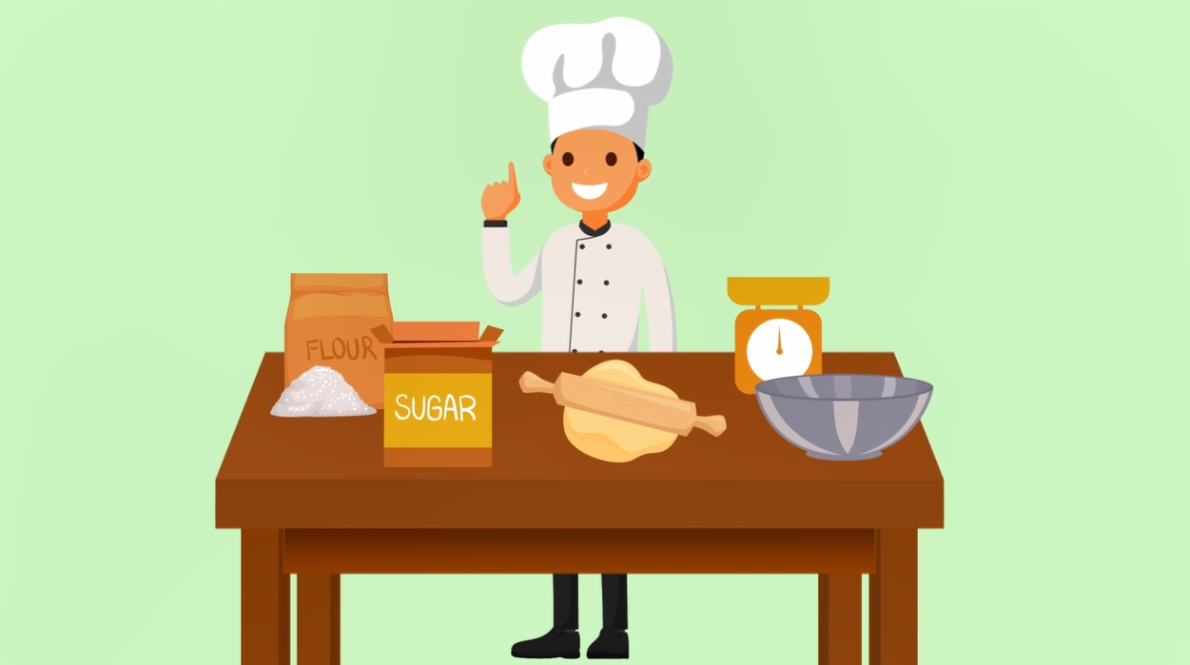
第三段
5
However, he did not give up.
然而，他並沒有放棄。

Slide 15
第三段
6
When other young guys of his age relaxed⁷ or dated girls during their free time, he put in extra working hours and sent most of his money home to his mother.
當其他同齡的年輕人在空閒時間放鬆或和女孩子約會的時候，他投入額外的時間工作，並把他大部分的錢寄回老家給母親。

Slide 16
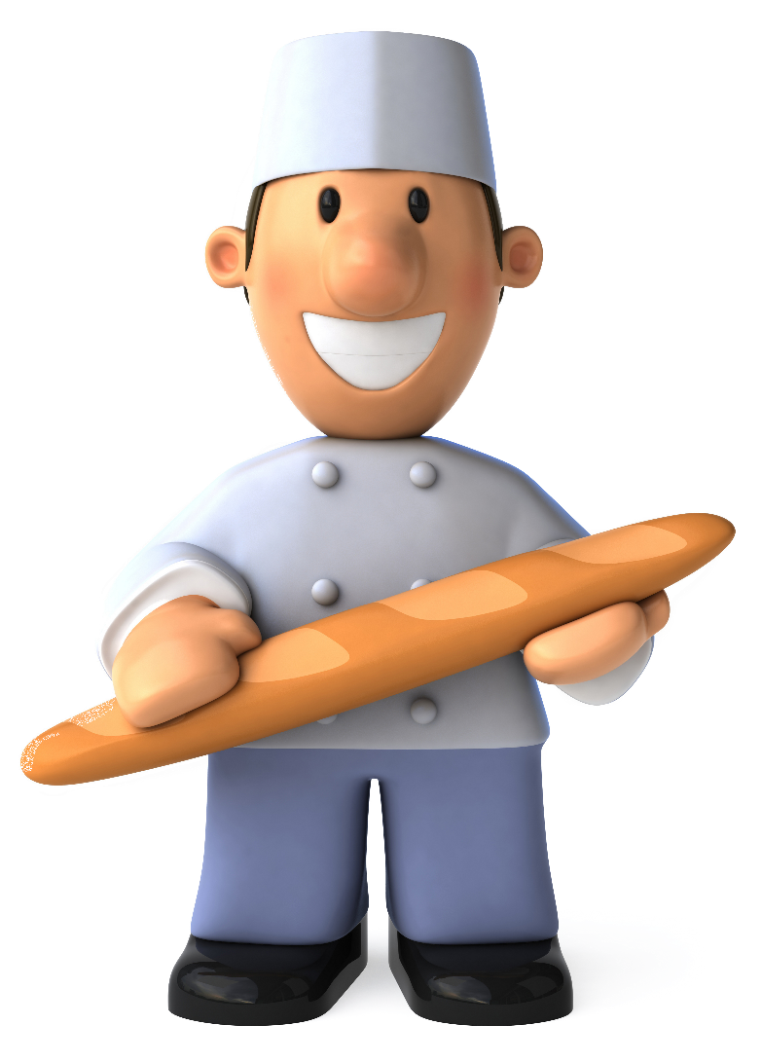
第四段
After years of practice⁸, Wu finally became a baker.
在多年的練習之後，吳師傅終於成為一位麵包烘焙師。

Slide 17
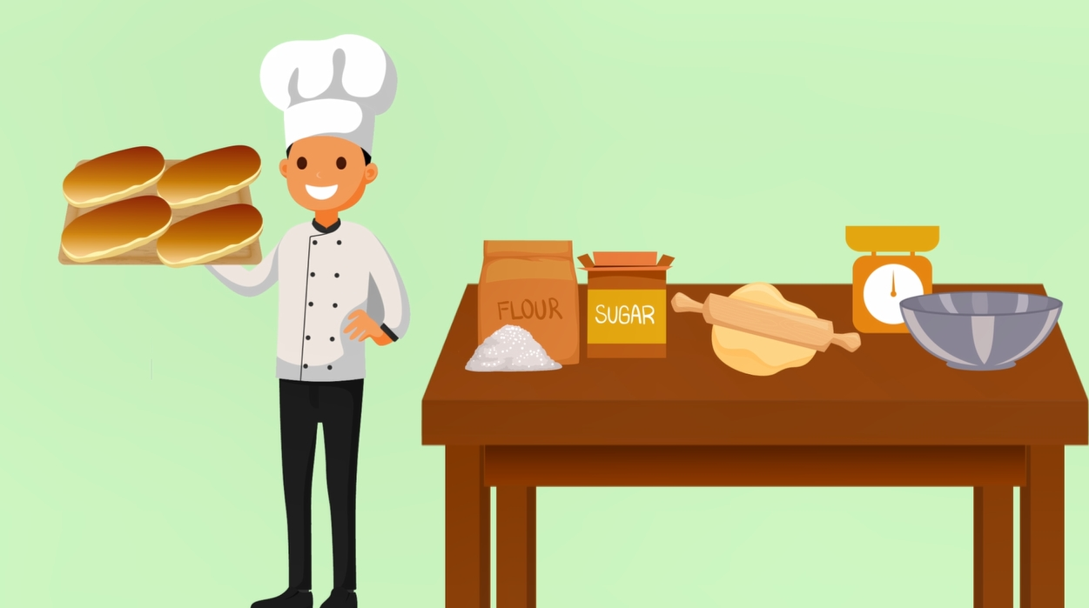
第四段
At first he did well, but his success⁹ did not last¹⁰ long.
起初他表現得很好，但他的成功並沒有持續很久。

Slide 18
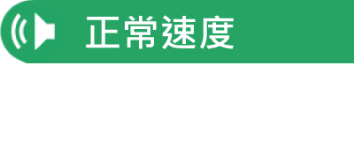
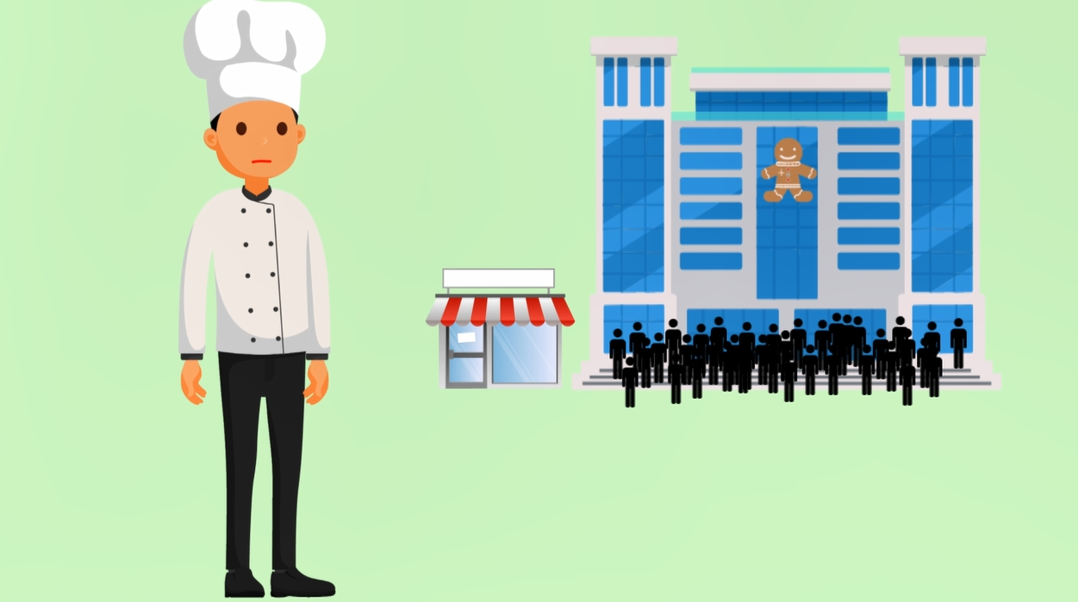
第四段
7
Customers¹¹ soon got tired of ordinary¹² bread and wanted something different.
顧客們很快地厭倦了普通的麵包，並想要嚐鮮。

Slide 19
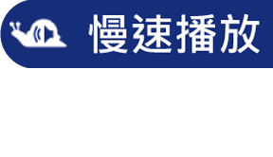
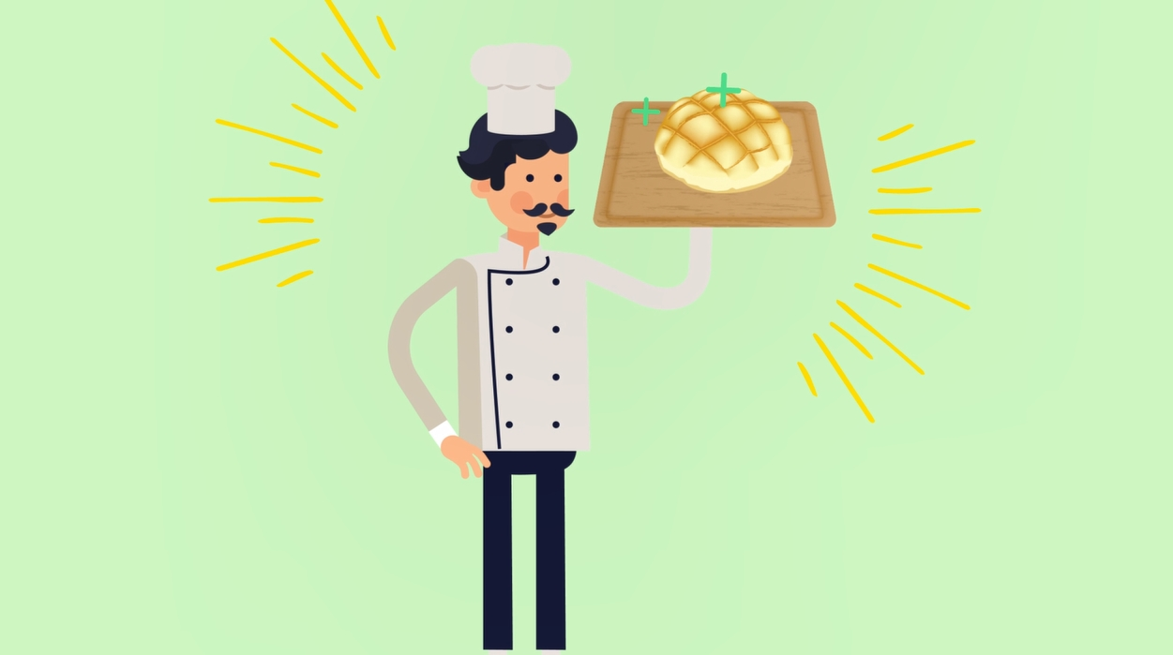
第四段
something different為後位修飾用法，亦可改寫為形容詞子句something that is different。
8
Fortunately, Wu met a true baking master, Fu-guang Chen.
幸運地，吳師傅遇見了一位真正的烘焙大師，陳撫洸。

Slide 20
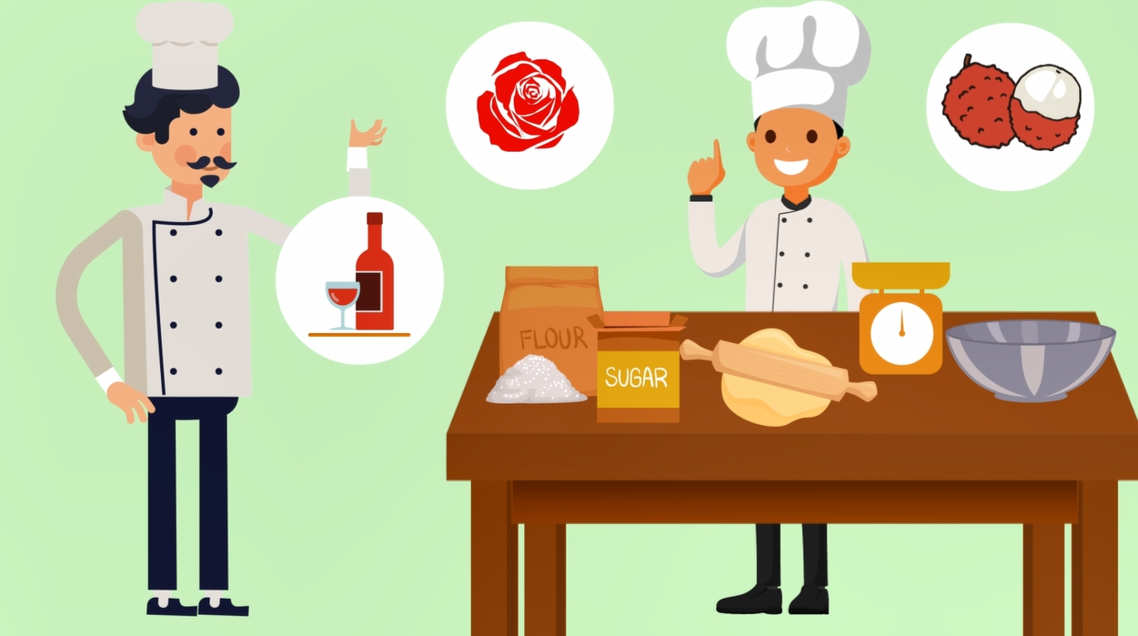
第四段
9
Chen helped him develop¹³ a different attitude¹⁴ toward baking, and he started using special ingredients◎, such as red wine, roses, and lychees◎.
陳師傅協助他培養了不同的烘焙態度，而他也開始使用特殊的烘焙原料，如紅酒、玫瑰及荔枝。

Slide 21
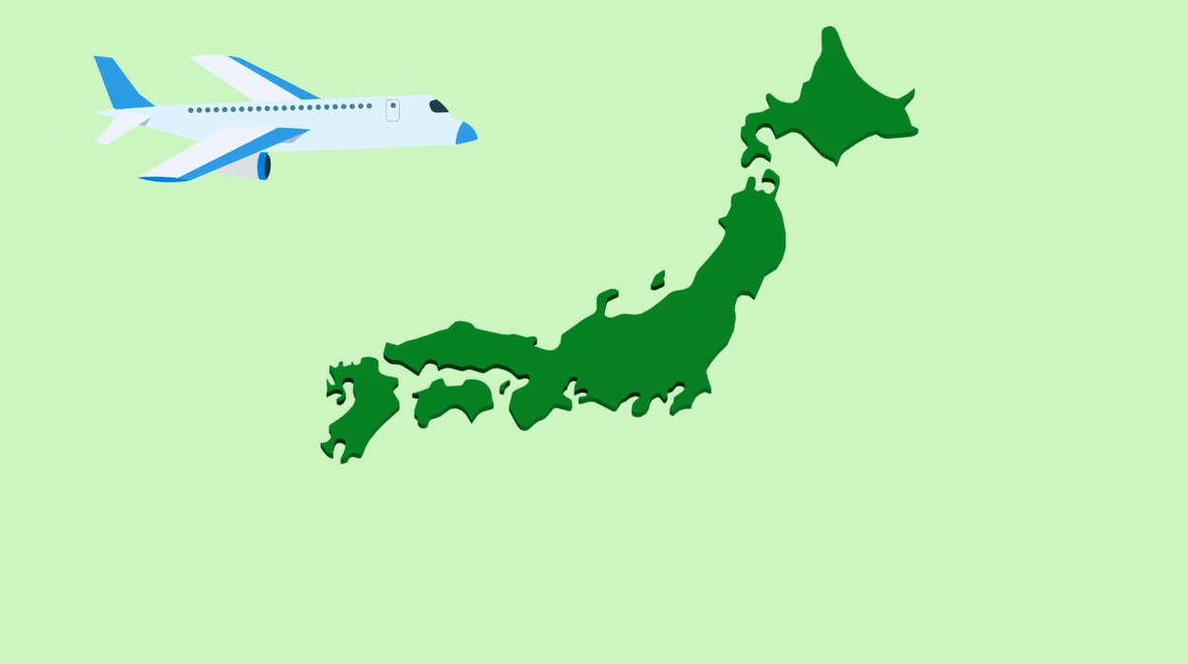
第四段
10
Because he wanted to get better at baking, he even went to Japan to learn more.
因為他想要更精進烘焙技術，甚至遠赴日本深造。

Slide 22
第四段
11
Over time, his hard work paid off, and he finally became an international¹⁵ baking master.
漸漸地，他的努力得到了回報，終於成為一位國際級的烘焙大師。

Slide 23
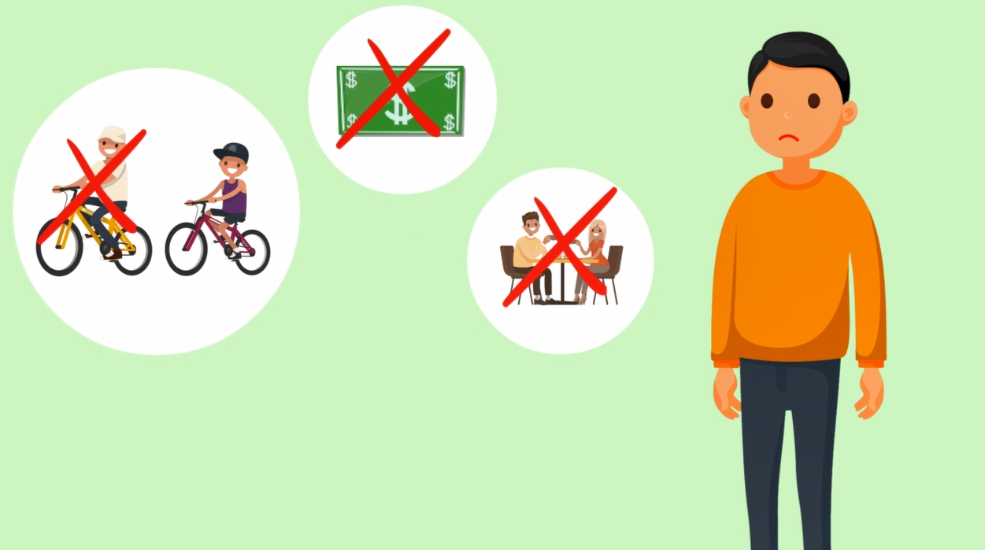
第五段
12
Although Master Wu did not enjoy a smooth¹⁶ start in life, he overcame¹⁷ many difficulties and fulfilled¹⁸ his dream.
雖然吳師傅的早年生活並不順遂，但他克服了許多的困難，並實現了他的夢想。

Slide 24
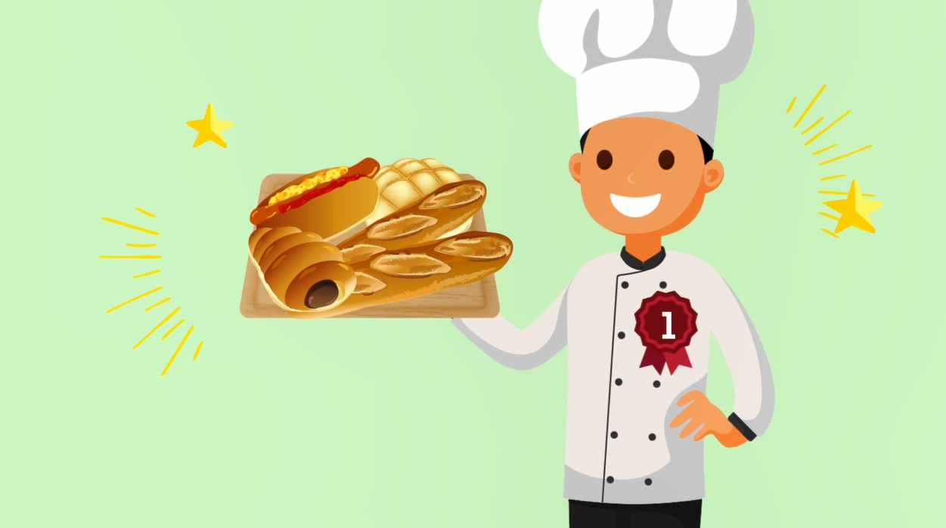
第五段
13
This is why he is not only a master baker but also living proof¹⁹ that hard work is the number one ingredient for success.
這就是為什麼他不僅是烘焙大師，也是活生生的證據，證明了努力是成功最重要的元素。

Slide 26
D
＿＿ 1. What is “Pao-Chun Wu: Master Baker and Dream Chaser” mainly about?
(A) The way to win the “World Cup of Baking.”
(B) The true master who taught Master Wu.
(C) Master Wu’s difficult family life.
(D) Master Wu’s spirit and hard work.

Slide 27
B
＿＿ 2. About Master Wu’s personal life, which of the following is NOT talked about in the reading?
(A) His place of birth.
(B) His marriage.
(C) His family members.
(D) His school life.

Slide 28
＿＿ 3. According to the reading, why did Master Wu go to Japan?
(A) He needed a break in order to relax and date girls.
(B) He hoped to become an even better baker.
(C) He wanted to earn more money for his family.
(D) He went to look for a very special ingredient.
B

Slide 29
C
＿＿ 4. According to the reading, which of the following is true?
(A) Master Wu became an international master in high school.
(B) Master Wu didn’t finish middle school because of his poor grades.
(C) Fu-guang Chen influenced Master Wu’s style of baking.
(D) Studying abroad was Master Wu’s dream when he was a child.

