Slide 1
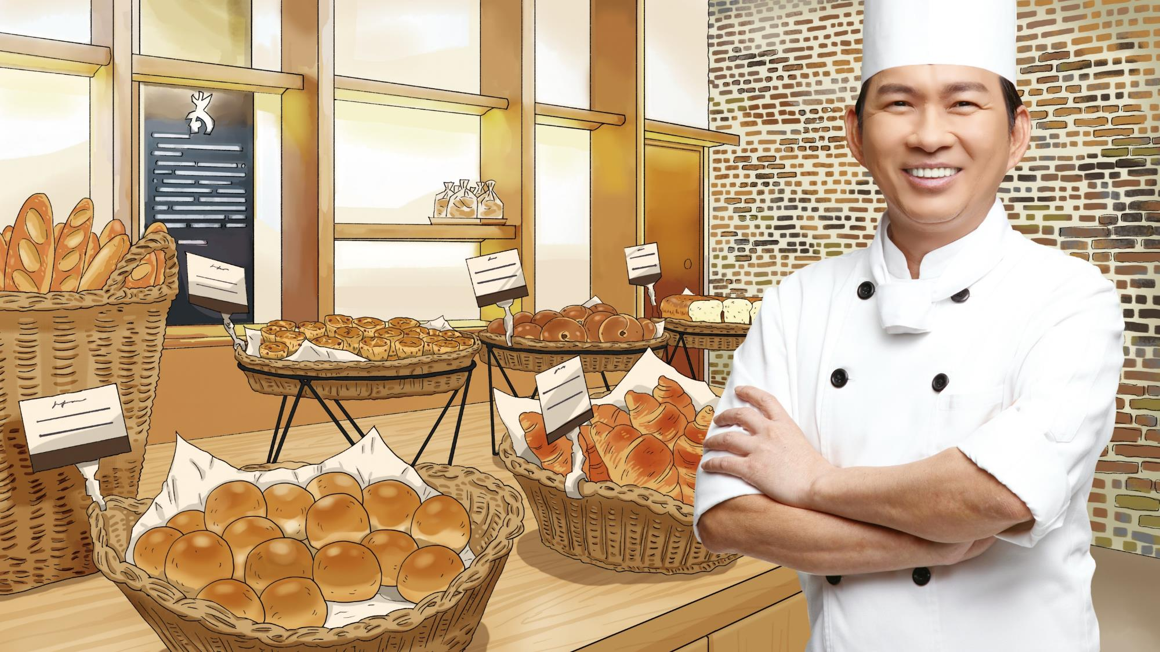
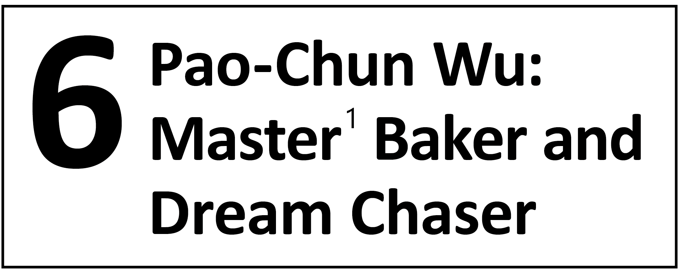
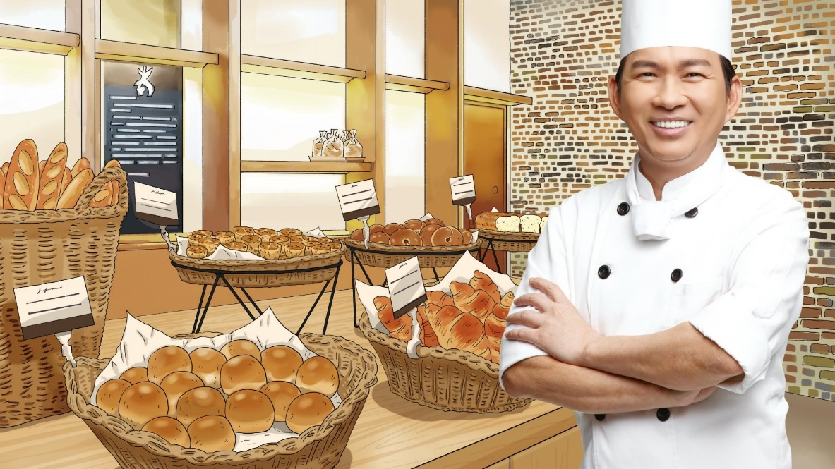



Slide 2
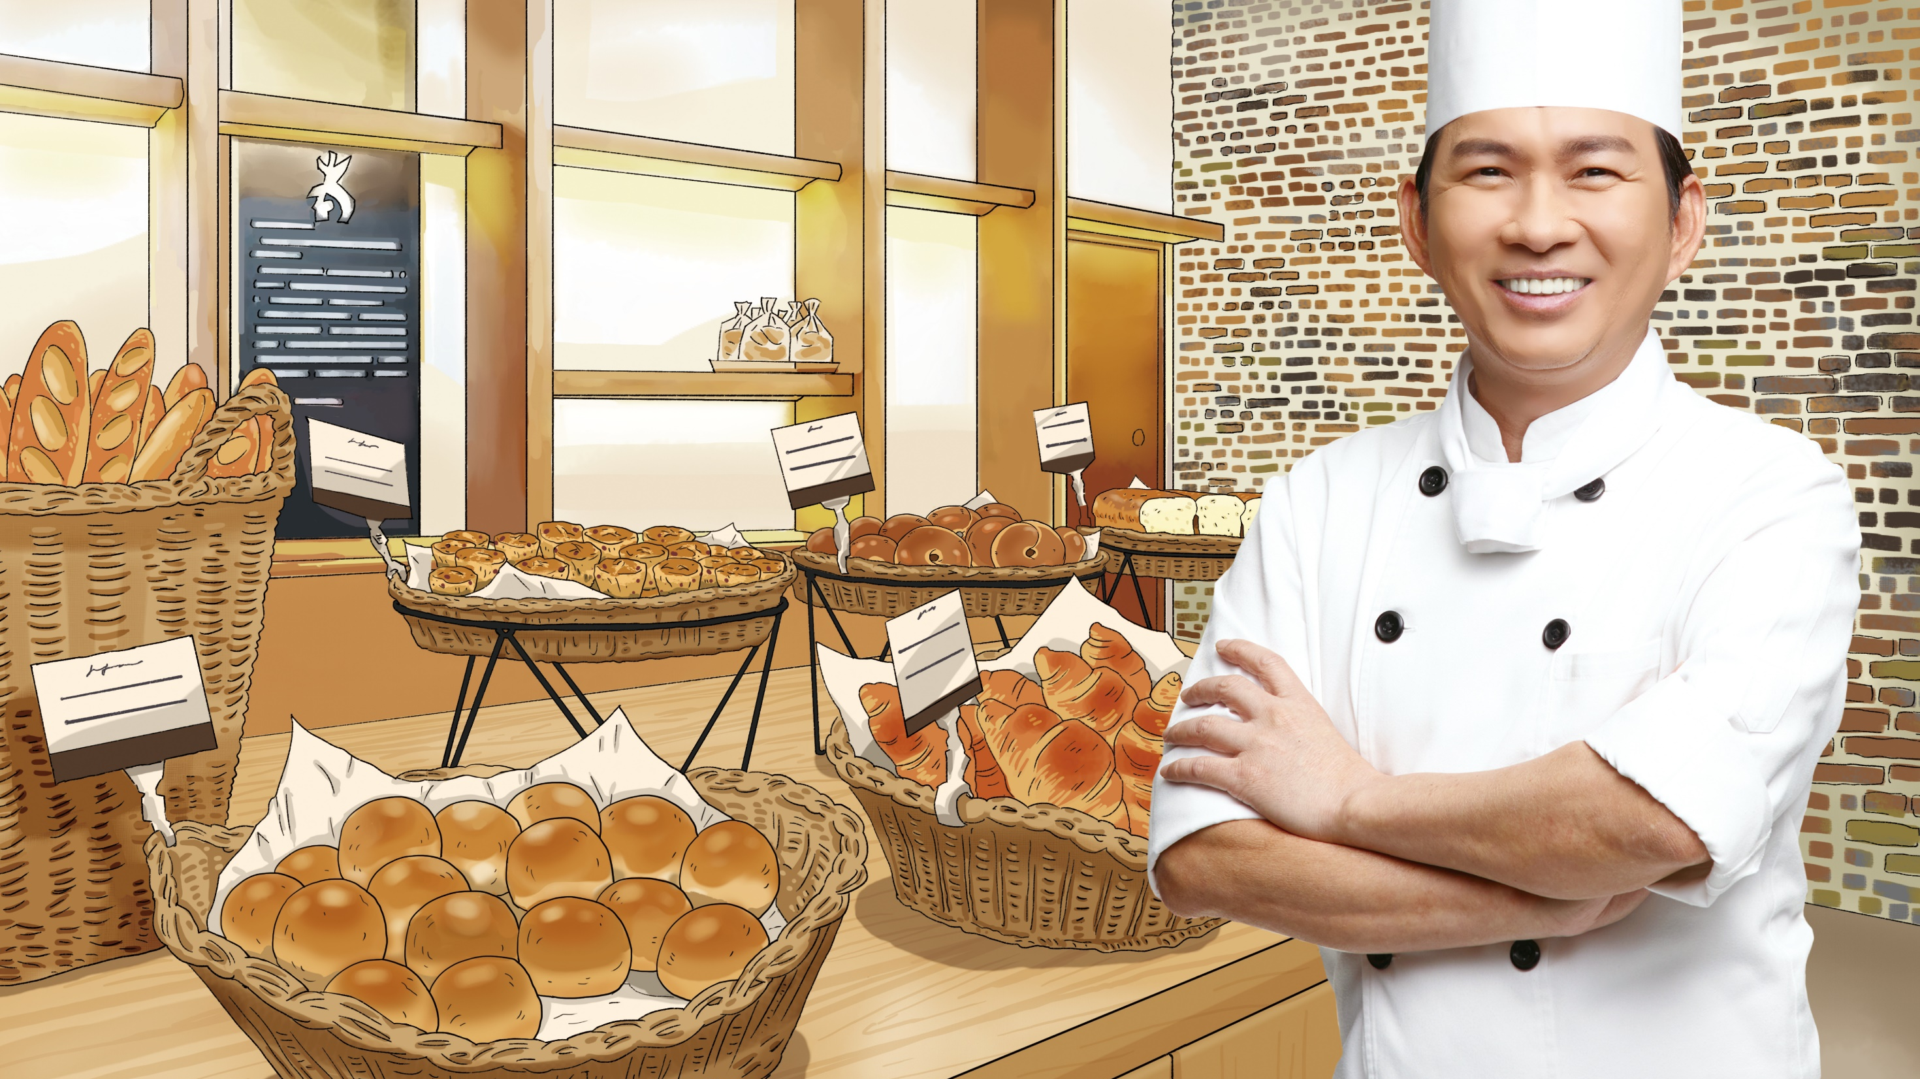









Check out the different kinds of delicious bread on the shelf of the bakery! How often do you visit a bakery or eat bread? What kind of bread is your favorite and why?
bagels
(貝果)
baguettes
(法式長棍麵包)
loaves (條)
of bread
muffins
(鬆糕；瑪芬)
croissants
(可頌)
buns
(小圓麵包)

Slide 3


Slide 4



補充
回課文
1. master
adj. 熟練的 being very skilled at something SYN skilled
Master kite makers will show their works at this weekend’s kite festival.
手藝高超的風箏製作大師們將在本週末的風箏節中展示他們的作品。

Slide 5

補充
回課文
2. perform
vi. 表現；vt. 演出 to do an action; to act
in a play in front of many people SYN act
To perform well, you need to work harder and be fully prepared.
要表現得好，你需要更努力且做好充分的準備。
The students will have to work together and perform a play at
the end of the school year.
學生們將需要同心協力在這學年尾聲時表演一齣戲劇。

Slide 6

補充
回課文
3. decide
vt. 決定 to make a choice after thinking about something SYN determine
Martin didn’t want to work for someone else for the rest of his life, so he decided to start his own business.
Martin 不想一輩子替別人工作，所以他決定自行創業。

Slide 7
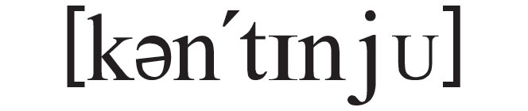
補充
回課文
4. continue
vt. vi. 繼續 to keep doing something
The kids continued playing video games until dinner time.
孩子們繼續玩電動直到晚餐時間。
Ms. Jones continued with her work after she returned home.
Jones 女士回到家後繼續工作。

Slide 8

補充
回課文
5. stage
n. [C] 階段；時期 a period within a longer process
Alice and Richard will get married in June and begin a new stage of their life.
Alice 和 Richard 將在六月完婚，並開啟他們人生的新階段。

Slide 9
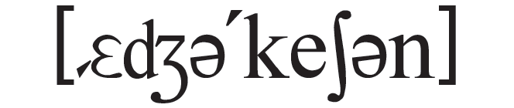
補充
回課文
6. education
n. [U] 教育 the action or process of teaching and learning
Family education is important to a child’s growth.
家庭教育對孩子的成長很重要。

Slide 10

補充
回課文
7. relax
vi. 放鬆 to feel calm and free from stress or worry
Taking a bath after a hard day’s work helps me relax.
辛苦工作一天後洗個澡幫助我放鬆。

Slide 11

補充
回課文
8. practice
n. [U] 練習 the action of doing something again and again in order to improve
No one is born an expert. It takes years of learning and practice.
沒有人天生就是專家。那需要多年的學習與練習。

Slide 12

補充
回課文
9. success
n. [U, C] 成功 the reaching of a goal;
someone or something that reaches the
desired goal ANT failure
Mike always believes in himself and that is the secret of his
success.
Mike 總是信任自己，而那就是他成功的祕訣。
The concert was a big success since more than six thousand people came to watch it.
那場音樂會非常成功，因為有超過六千人前來觀賞。

Slide 13

補充
回課文
10. last
vi. 持續 to continue for a certain period of time
The meeting lasted for hours, but we still didn’t come to the final decision.
會議持續了數小時，但我們還沒有達成最後的決議。

Slide 14
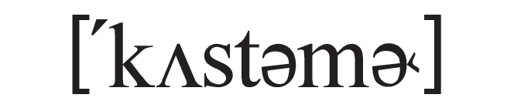
補充
回課文
11. customer
n. [C] 顧客 someone who buys something or pays for a certain service
Regular customers of this airline can enjoy lower ticket prices.
這間航空公司的常客能享受較低的購票價格。

Slide 15

補充
回課文
12. ordinary
adj. 普通的 usual or common ANT special, rare
The famous movie star wishes to have a more ordinary life.
這知名的影星希望能過較平凡的生活。

Slide 16


補充
回課文
13. develop
vt. 發展 to make something grow or become mature
Your idea is great, so you just have to develop it into a workable◎ plan.
你的想法很棒，所以你只需要將這想法發展成一個切實可行的方案。
◎workable adj. 切實可行的

Slide 17
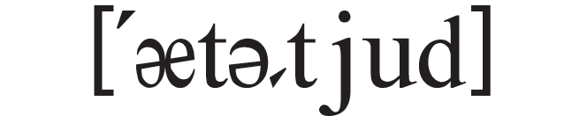
補充
回課文
14. attitude
n. [C] 看法；態度 a feeling or an opinion about something
Having a positive attitude is the key to happiness.
擁有正向的態度是快樂的關鍵。

Slide 18
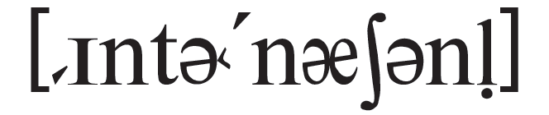
補充
回課文
15. international
adj. 國際的 involving more than one country or all countries
Gal Gadot became an international star because of her role as Wonder Woman◎.
Gal Gadot 因飾演神力女超人這個角色而成為國際級的明星。
◎Wonder Woman 神力女超人

Slide 19

補充
回課文
16. smooth
adj. 順利的；光滑的 moving without shaking or sudden changes of direction; having a surface that is flat and not rough
We left in the morning and had a smooth flight to New York.
我們早上啟程並順利飛抵紐約。
This pillow feels very soft and smooth, and it helps me have a good night’s sleep.
這枕頭摸起來柔軟又光滑，而且它助我一夜好眠。

Slide 20
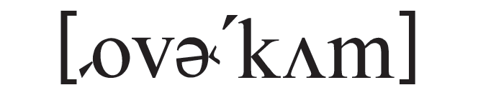
補充
回課文
17. overcome
vt. 克服 to succeed in dealing with
something difficult (overcome – overcame – overcome)
Believe in yourself, and you will overcome all the difficulties that lie ahead.
信任你自己，那麼你就會克服前方所有的困難。

Slide 21

補充
回課文
18. fulfill
vt. 實現 to complete or achieve something
After many years, Jennifer fulfilled her dream of writing a book.
多年之後，Jennifer 實現了她寫書的夢想。
fulfill
fulfil

Slide 22


補充
回課文
19. proof
n. [U] 證明 details that can show that a certain fact is true
There still isn’t any real proof of the existence◎ of aliens.
現在還沒有任何確切的證據來證明外星人的存在。
◎existence n. [U] 存在

Slide 23
補充
回課文
1. be born into
出生於⋯⋯（的家庭背景）
Bruce Wayne was born into a rich family. He never had to worry about money.
Bruce Wayne 出生於富裕家庭。他從來不需要擔心錢的問題。

Slide 24
補充
回課文
2. make ends meet
使收支平衡；勉強餬口
The worker earns little, so it is hard for him to make ends meet.
這個工人賺的錢很少，所以他很難保持收支平衡。

Slide 25
補充
回課文
3. give up
放棄 SYN quit
The doctor asked my father to give up smoking and start living a healthier life.
醫師要我父親戒菸並開始過比較健康的生活。

Slide 26
補充
回課文
4. put in
投入⋯⋯（時間、努力等）
Jason puts in a lot of extra time at his company during evenings and weekends.
Jason 在晚上及週末時投入許多額外的時間在公司工作。

Slide 27
補充
回課文
5. be/get tired of
對⋯⋯感到厭倦
The kids got tired of watching TV at home and begged their parents to take them out.
孩子們厭倦在家看電視，懇求爸媽帶他們出門。

Slide 28
補充
回課文
6. over time
逐漸地
The things we enjoy doing and our attitudes toward life often change over time.
我們喜愛做的事以及對人生的態度經常隨時間逐漸改變。

Slide 29
補充
回課文
7. pay off
有所回報
Keep trying! I’m sure your hard work will pay off and you will make it someday!
繼續嘗試！我確信你的努力將有所回報，而且有一天你會成功！

